Slide 1
Integrating Computational Tools into foreign policy analysis
INTRODUCING MESA PACKAGES with A U.S. foreign policy case study
Tom Pike
18 April 2018

Slide 2
Agenda
Emergent Behavior
Coalition Formation Example
Toy Example
Libya Policy Example
Possibilities
Mesa Packages
Overview
How To
Future
Questions

Slide 3


Emergent Behavior
OBSERVED
Starting code form scratch
Adapt existing models – Netlogo, MASON, RePast
But where is…
Citing/using packages inside model
POSSIBLE
Optimized libraries of aspects of ABMs
Already common practice for ML and NN
Goal Behavior
Modelers incorporate a variety of packages to build richer models

Slide 4


Example – Gradient Descent Optimizer
TensorFlow:
7 Classes (1st Layer)
Calls 11,400 lines of code*
*Doesn’t use all of them, but one of 11 calls and I am not a computer scientist
For me to call:
optimizer = tf.train.GradientDescentOptimizer(0.5).minimize(loss)

Slide 5
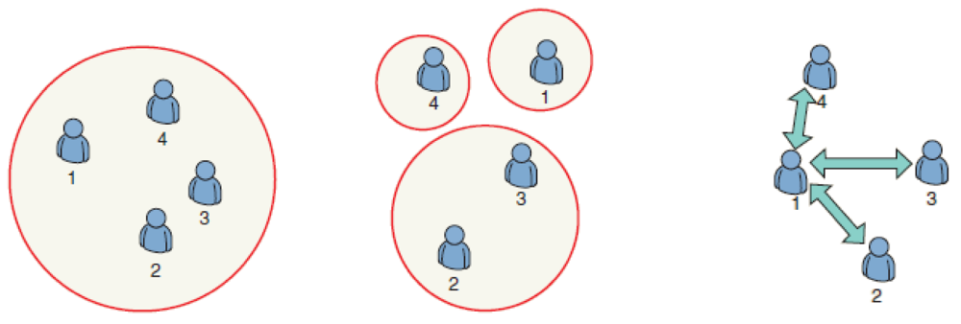
Example- Bilateral Shapley Value
Coalition Game Theory- How agent coalesce to form groups
Transmission line siting*
Politicians supporting a bill
Villagers in civil conflict
Impact of U.S. Support…
Hai-Yan Shi et al., “Game Theory for Wireless Sensor Networks: A Survey,” Sensors 12, no. 7 (July 2, 2012): 9055–97, doi:10.3390/s120709055.
*Mark Abdollahian, Yang Zinig, and Hal Nelson, “Techno-Social Energy Infrastructure Siting : Sustainable Energy Modeling Programming ( SEMPro ),” Journal of Artifical Socieities and Simulation 16, no. 3 (2013): 1–12.

Slide 6
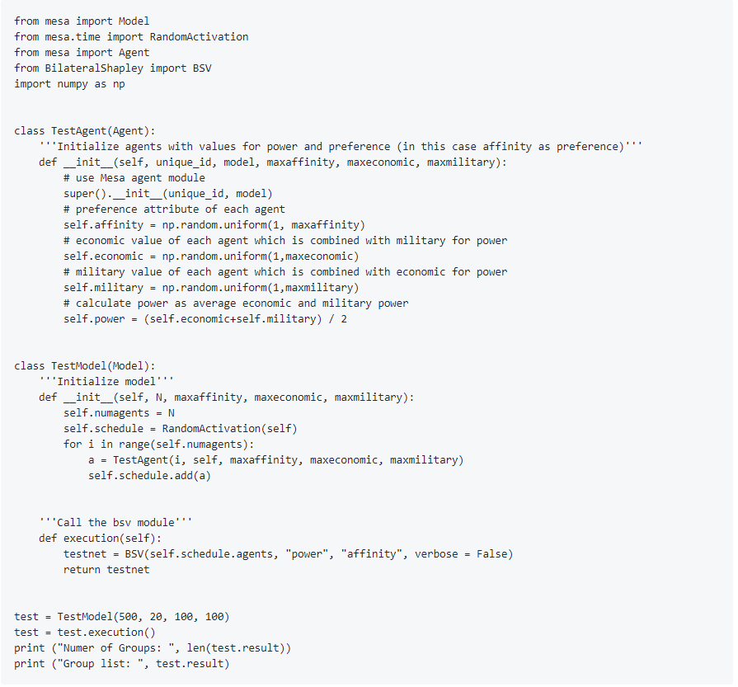
Example- Bilateral Shapley Value
DATA-AGENTS
BSV
RESULTS

Slide 7
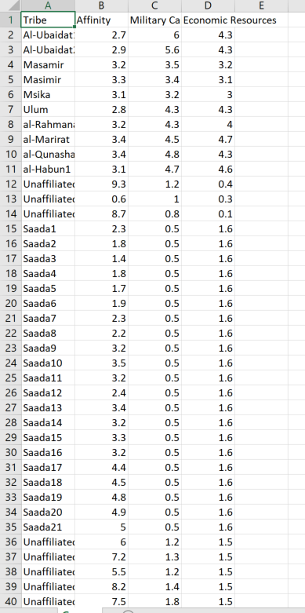
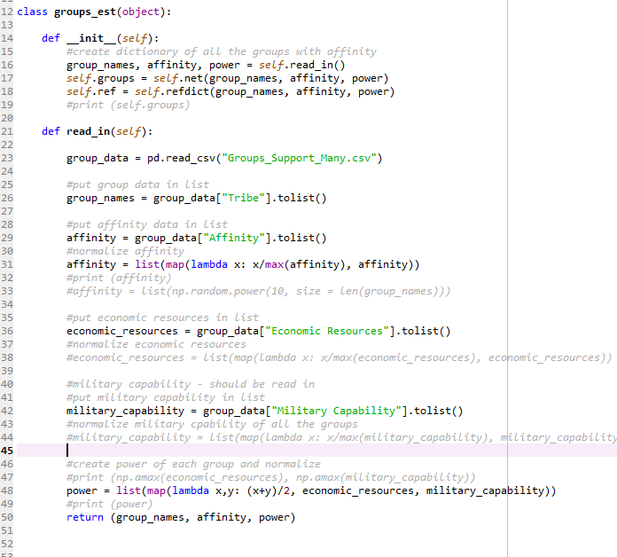
EXAMPLE – BSV- LIBYA
LIBYA ASSESSMENT
BSV
RESULTS

Slide 8
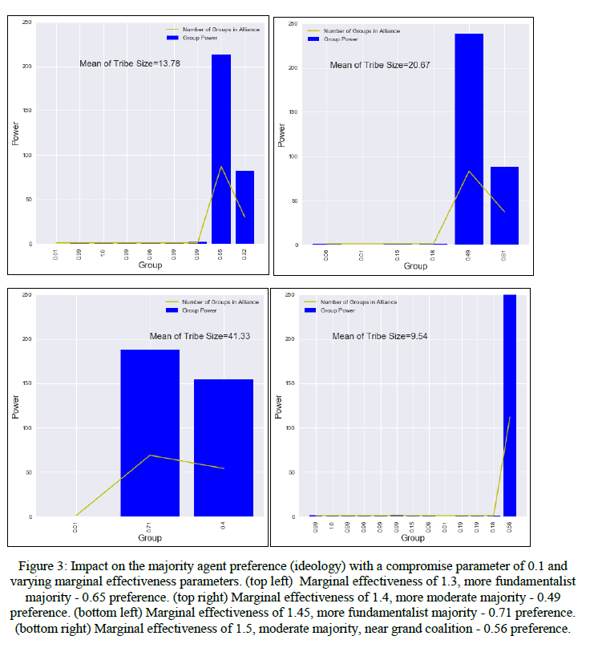
EXAMPLE – BSV- LIBYA- RESULTS
LIBYA ASSESSMENT
BSV
RESULTS

Slide 9
Possibilities
Cognition:
PECS
Fast and Frugal
EA with Hebbian Learning
Agent Movement/Sleep
Theory Mix and Match
Same Landscape-different parts
Little Jones Creek
Frogs
Fish
Birds
Trees
Cython and Jython
WEATHER VARIANCE
AGENT SITUATION
BSV
CONFLICT ONSET
RESULTS
Zining Yang and Piotr M Zagorowski, “Climate Variability , Opposition Group Formation and Conflict Onset,” 2017.

Slide 10




Mesa packages- Trifecta
https://github.com/projectmesa/mesa/wiki/Mesa-Packages
PACKAGE ON GITHUB (or SIMILAR)
LINK ON MESA WIKI
USER
https://github.com/tpike3/bilateralshapley
https://github.com/econ-ark
http://mesa.readthedocs.io/en/master/packages.html

Slide 11
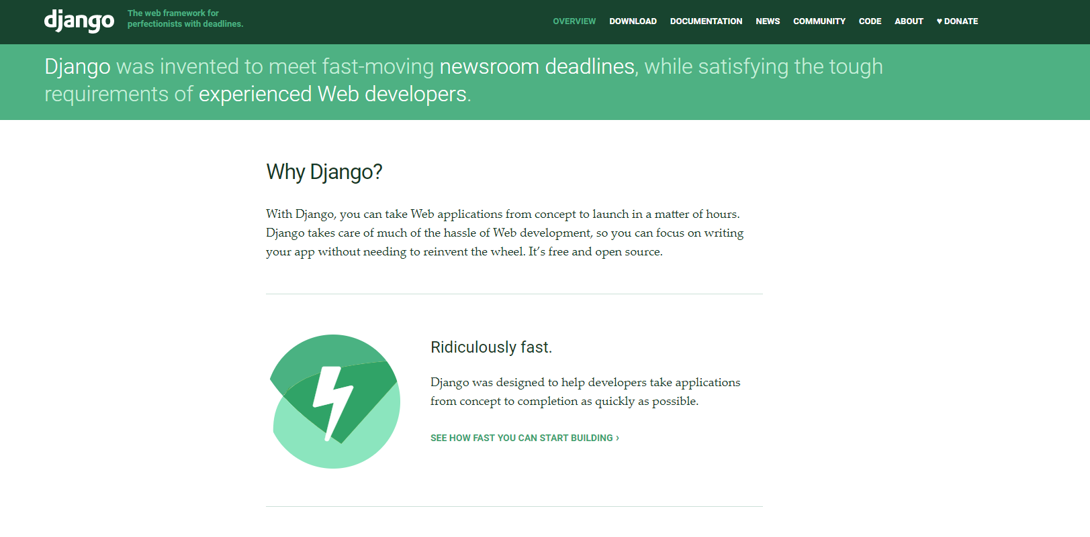
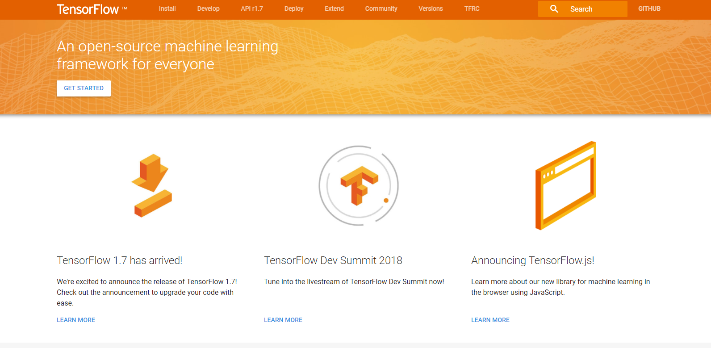
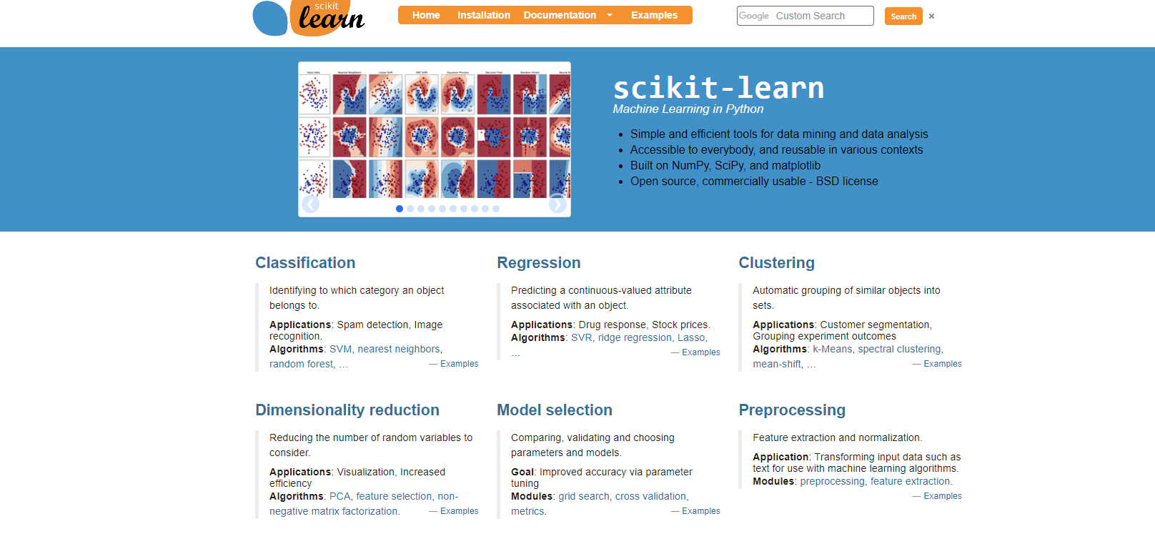
FUTURE – At 10 packages?
Why is this more important than convenience?

Slide 12
SCIENCE
Reproducibility – Others one can run it and get the same result*
Replicability - Others can replicate the results across similar phenomenon*
Research – Easier to find out why the results could not be reproduced or replicated
Which will hopefully lead us to….
* Jeffrey T. Leek and Roger D. Peng, “Reproducible Research Can Still Be Wrong: Adopting a Prevention Approach,” Proceedings of the National Academy of Sciences 112, no. 6 (2015): 1645–46, doi:10.1073/pnas.1421412111.

Slide 13
A comprehensive Complex systems paradigm
Bottom up models are virtual laboratories where controlled experiments distinguish noise from signal in the systems organization…. This approach may change our whole notion of scientific theory, which until now has been based on the theories of physics. Theories of complex systems may never be reducible to simple analytical equations, but are more likely to be sets of conceptually simple mechanisms (e.g. Darwinian natural selection) that produce different dynamics and outcomes in different contexts.
Volker Grimm et al, “Pattern Oriented Modeling of Agent Based Complex Systems: Lessons from Ecology” Science, New Series, Vol. 310, No. 5750 (Nov. 11, 2005), pp. 987-991

Slide 14
QUESTIONS

